Slide 1
AOP IN C#
Introduction to Aspect-Oriented-Programming

Slide 2
@Antya Dev
http://antyadev.blogspot.com/
https://twitter.com/AntyaDev

Slide 3
Topics
What is bad and good design ?
Problem statement.
What is AOP ?
Demo

Slide 4
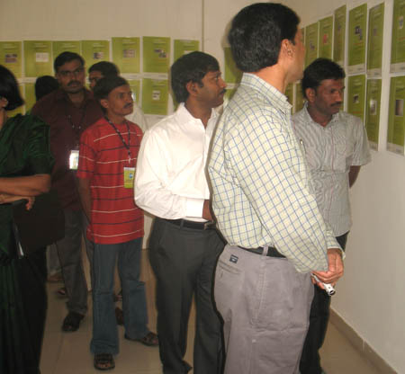
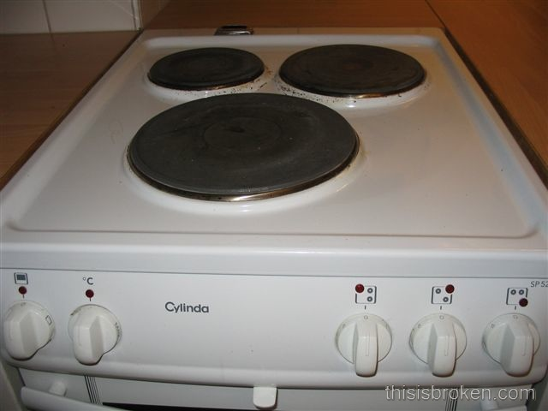
What is bad design ?

Slide 5
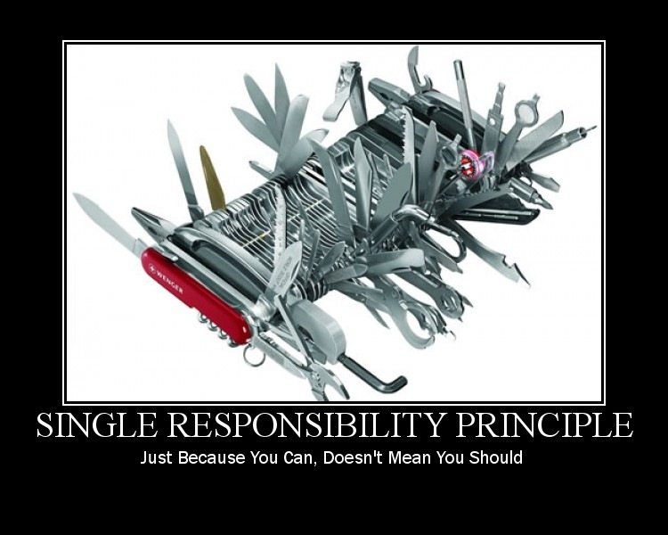

Slide 6
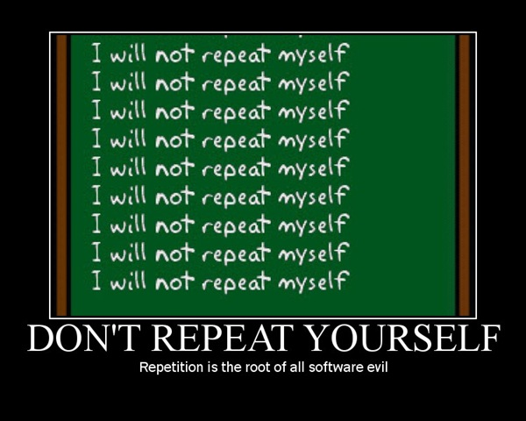

Slide 7
What is bad design ?
the system is rigid: it's hard to change a part of the system without affecting too many other parts of the system
the system is fragile: when making a change, unexpected parts of the system break
- the system or component is immobile: it is hard to reuse it in another application because it cannot be disentangled from the current application

Slide 8

class GarbageService
{
public void Transfer(int sourceID, int destinationID, int size)
{
Storage source = Storage.GetById(sourceID);
Storage destination = Storage.GetById(destinationID);
var garbage = source.GetGarbage(size);
destination.PutGarbage(garbage);
}
}

Slide 9
class GarbageService
{
public void Transfer(int sourceID, int destinationID, int size)
{
Trace.TraceInformation("Entering GarbageService.Transfer( sourceID={0},destinationID={1})", sourceID, destinationID);
try
{
Storage source = Storage.GetById(sourceID);
Storage destination = Storage.GetById(destinationID);
var garbage = source.GetGarbage(size);
destination.PutGarbage(garbage);
}
catch (Exception ex)
{
Trace.TraceError("Exception: GarbageService.Transfer( sourceID = {0}, destinationID = {1}) failed : {2}“, sourceID, destinationID, ex.Message);
throw;
}
}
}

Slide 10
class GarbageService
{
public void Transfer(int sourceID, int destinationID, int size)
{
Trace.TraceInformation("Entering GarbageService.Transfer(sourceID = {0}, destinationID = {1})", sourceID, destinationID);
if (sourceID <= 0)
{
throw new ArgumentOutOfRangeException("sourceID");
}
if (destinationID <= 0)
{
throw new ArgumentOutOfRangeException("destinationID");
}
if (size <= 0)
{
throw new ArgumentOutOfRangeException("size");
}
try
{
Storage source = Storage.GetById(sourceID);
Storage destination = Storage.GetById(destinationID);
var garbage = source.GetGarbage(size);
destination.PutGarbage(garbage);
}
catch (Exception ex)
{
Trace.TraceError("Exception: GarbageService.Transfer(sourceID = {0}, destinationID = {1}) failed : {2}“, sourceID, destinationID, ex.Message);
throw;
}
}
}

Slide 11
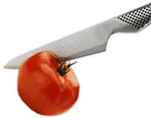
Requirements
Functional Requirements
Line-of-business
Non functional requirements
Logging
Caching
Transaction
Validation
Exception Handling
Thread Sync
GUI Binding
… and a lot more!
Cross-Cutting Concerns

Slide 12
What is AOP ?
AOP - is a programming paradigm which aims to increase modularity by allowing the separation of cross-cutting concerns.
AOP - an approach that extends OOP and addresses the issue of cross-cutting concerns:
Encapsulate cross-cutting concerns into Aspects.
Improves code reusability, modularity and separation of concerns.
Reduces defects by reducing boiler – plate code.
With AOP, you still define the common functionality in one place, but you can declaratively define how and where this functionality is applied without having to modify the class to which you are applying the new feature.

Slide 13
AOP
doesn’t solve any new problem
it’s just another tool in your toolbox
the main goal is nice separation of concerns
a decrease in development costs and software delivery time;
an increase in application maintainability.
reduce noise in source == more clean model

Slide 14
AOP Terminology
Join Point
place where behavior can be added
Advice
code that can be injected at join points
Point Cut
join points where advices should be applied
Aspect
container holding point cuts and advice

Slide 15
AOP WEAVING
Compile time weaving
Source-Level Weaving
Modifying the MSIL code
Run-Time weaving
Dynamic Proxy

Slide 16
Comparing Aspect Frameworks
Static vs Dynamic AOP
Spring.NET
Castle
MS Unity/PIAB
PostSharp
LinFu
Build-Time:
Very Expressive
Robust Model
Not Invasive Static
Hybrid
Run-Time: Less Expressive Brittle Model
Invasive Dynamic

Slide 17
Demo

Slide 18
Comparing Aspect Frameworks
Expressiveness
What can you do with the framework?
 | PostSharp | Linfu | Spring.NET Castle | Unity/PIAB
Method Interception | Yes | Yes | Yes | Yes
Private/Sealed Member Interception | Yes | Yes
Event Interception | Yes
Member Introduction | Yes

Slide 19
We need Aspects!

Slide 20
We have great frameworks!

